Slide 1
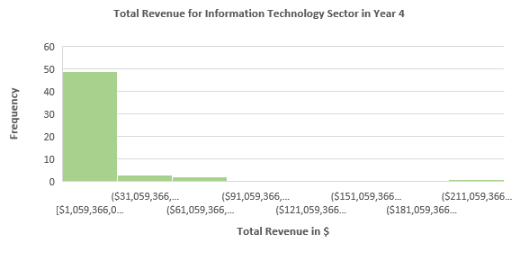
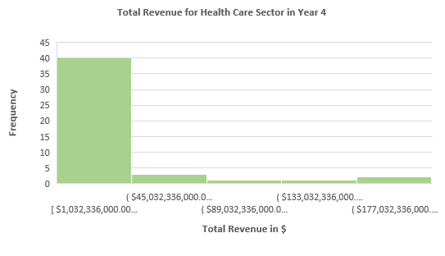
Does the Health Care sector's revenue expenditure level compare favorably to that of the IT sector in Year 4?
The following are the graphs for the annual revenue reported for all companies in the Health Care and IT sectors in year 4.
Both distributions have positive or right-skewed skewness. This indicates that the mean is higher than the median for each.
The mean for Health care is about $27 billion, and for Information Technology is $16 billion. However, the median for Information Technology is $5 billion. While the median for health care is $10 billion.
Health care has a standard deviation of $45067079223.4665, whereas the IT sector is $32915809921.4897.
The IT sector as a higher range of 2.14 , compared to the health care sector of 1.89 .
From these values, we can note that the IT sector is more spread than the health care sector.

